Slide 1

English
PROJECT-WORK

Slide 2
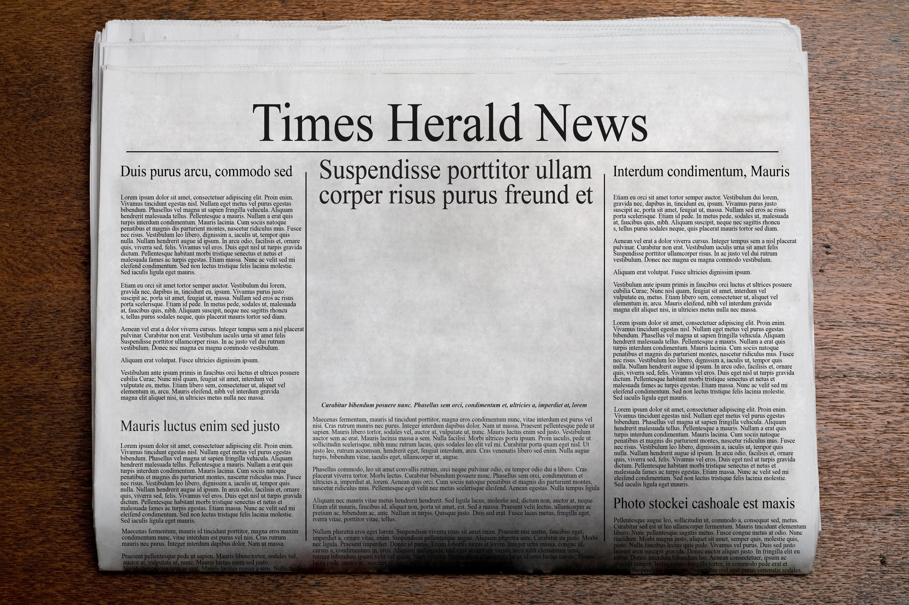
FUTURE TIMES 2045
Here is your chance to be a journalist in the future!
Your task:
You and your team have to bring out the summer edition of your regional newspaper in the year 2045.
What do you think will happen in 20 years? How far has technology come? What events are happening? What problems will there be?
Write about it in your own digital newspaper!

Slide 3
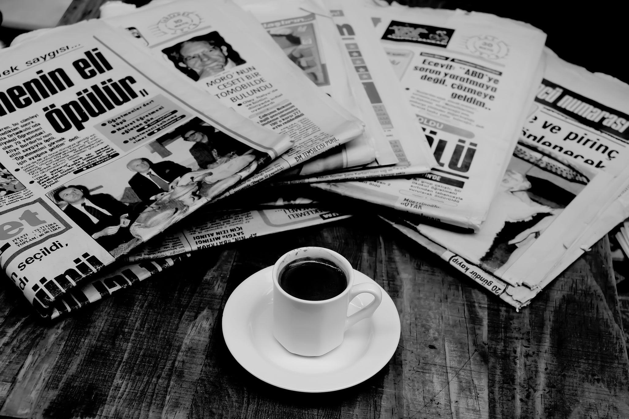
How to?
The platform you will use is Genially.com.
There, you will find a template that is ready to be used!
If you want, you can make changes!
You will also get a project worksheet that helps you organize the newspaper and keep track on your tasks.
Brainstorm article topics
Think about the layout
Fill out your project worksheet
Assign roles

Slide 4
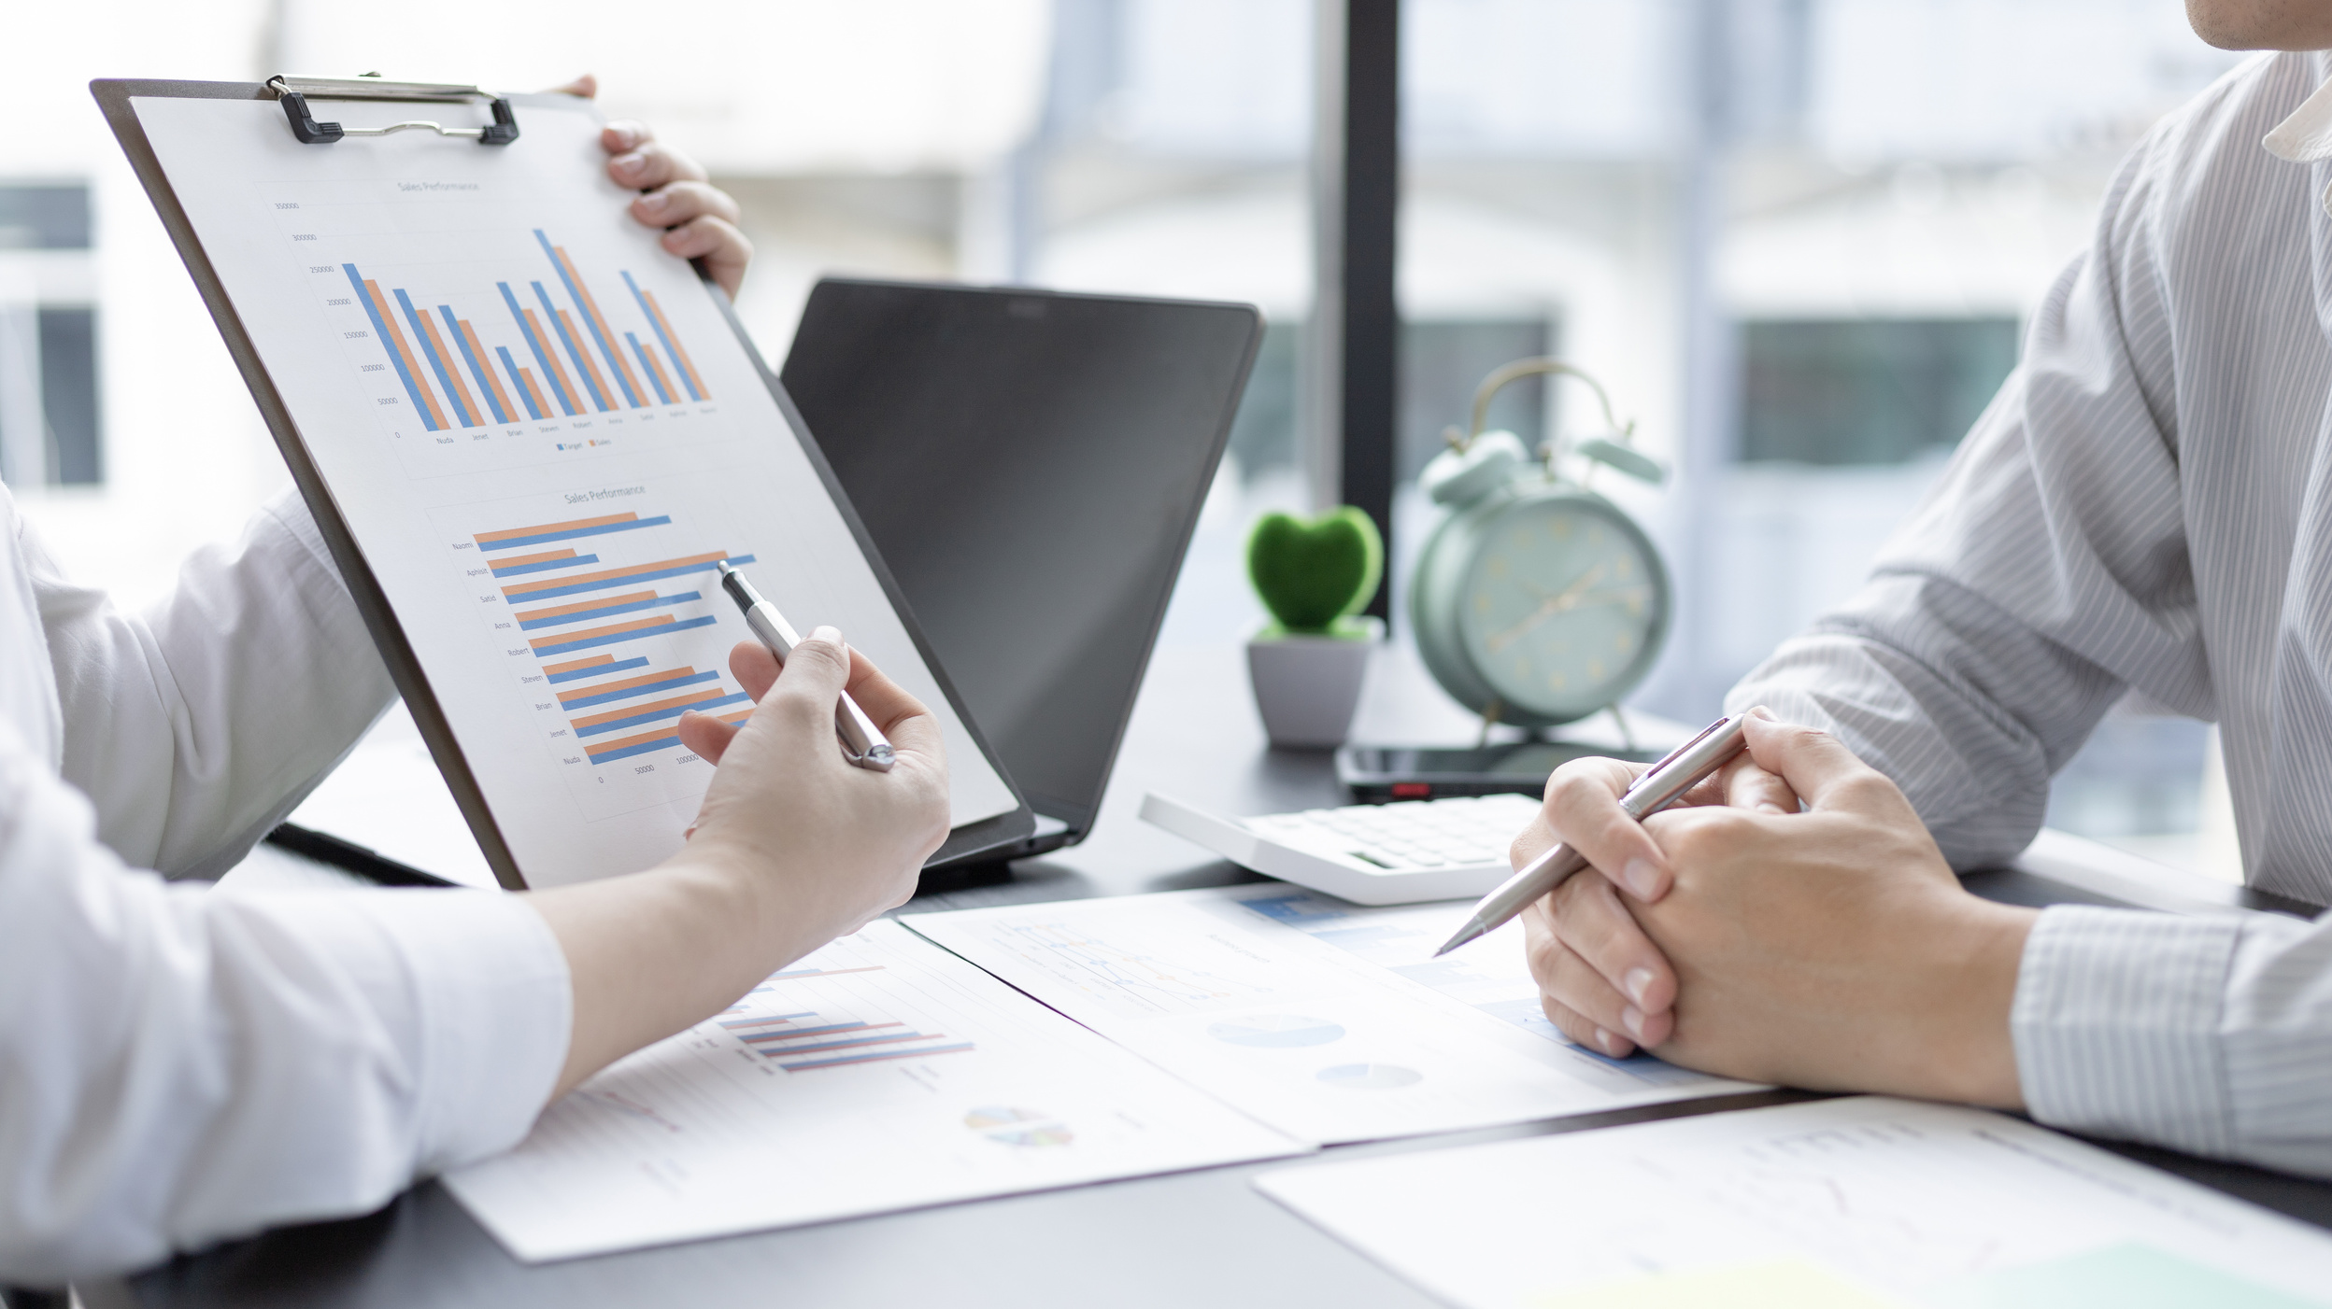

Requirement
  Everybody has to write one article (=1 newspaper page)
  There has to be some kind of visual (picture, graph,...)
  The newspaper has to have
- a frontpage
- an index
- a last page with the
group members and
their assigned roles
  The filled out project worksheet (keep your deadlines in mind!!)

Slide 5
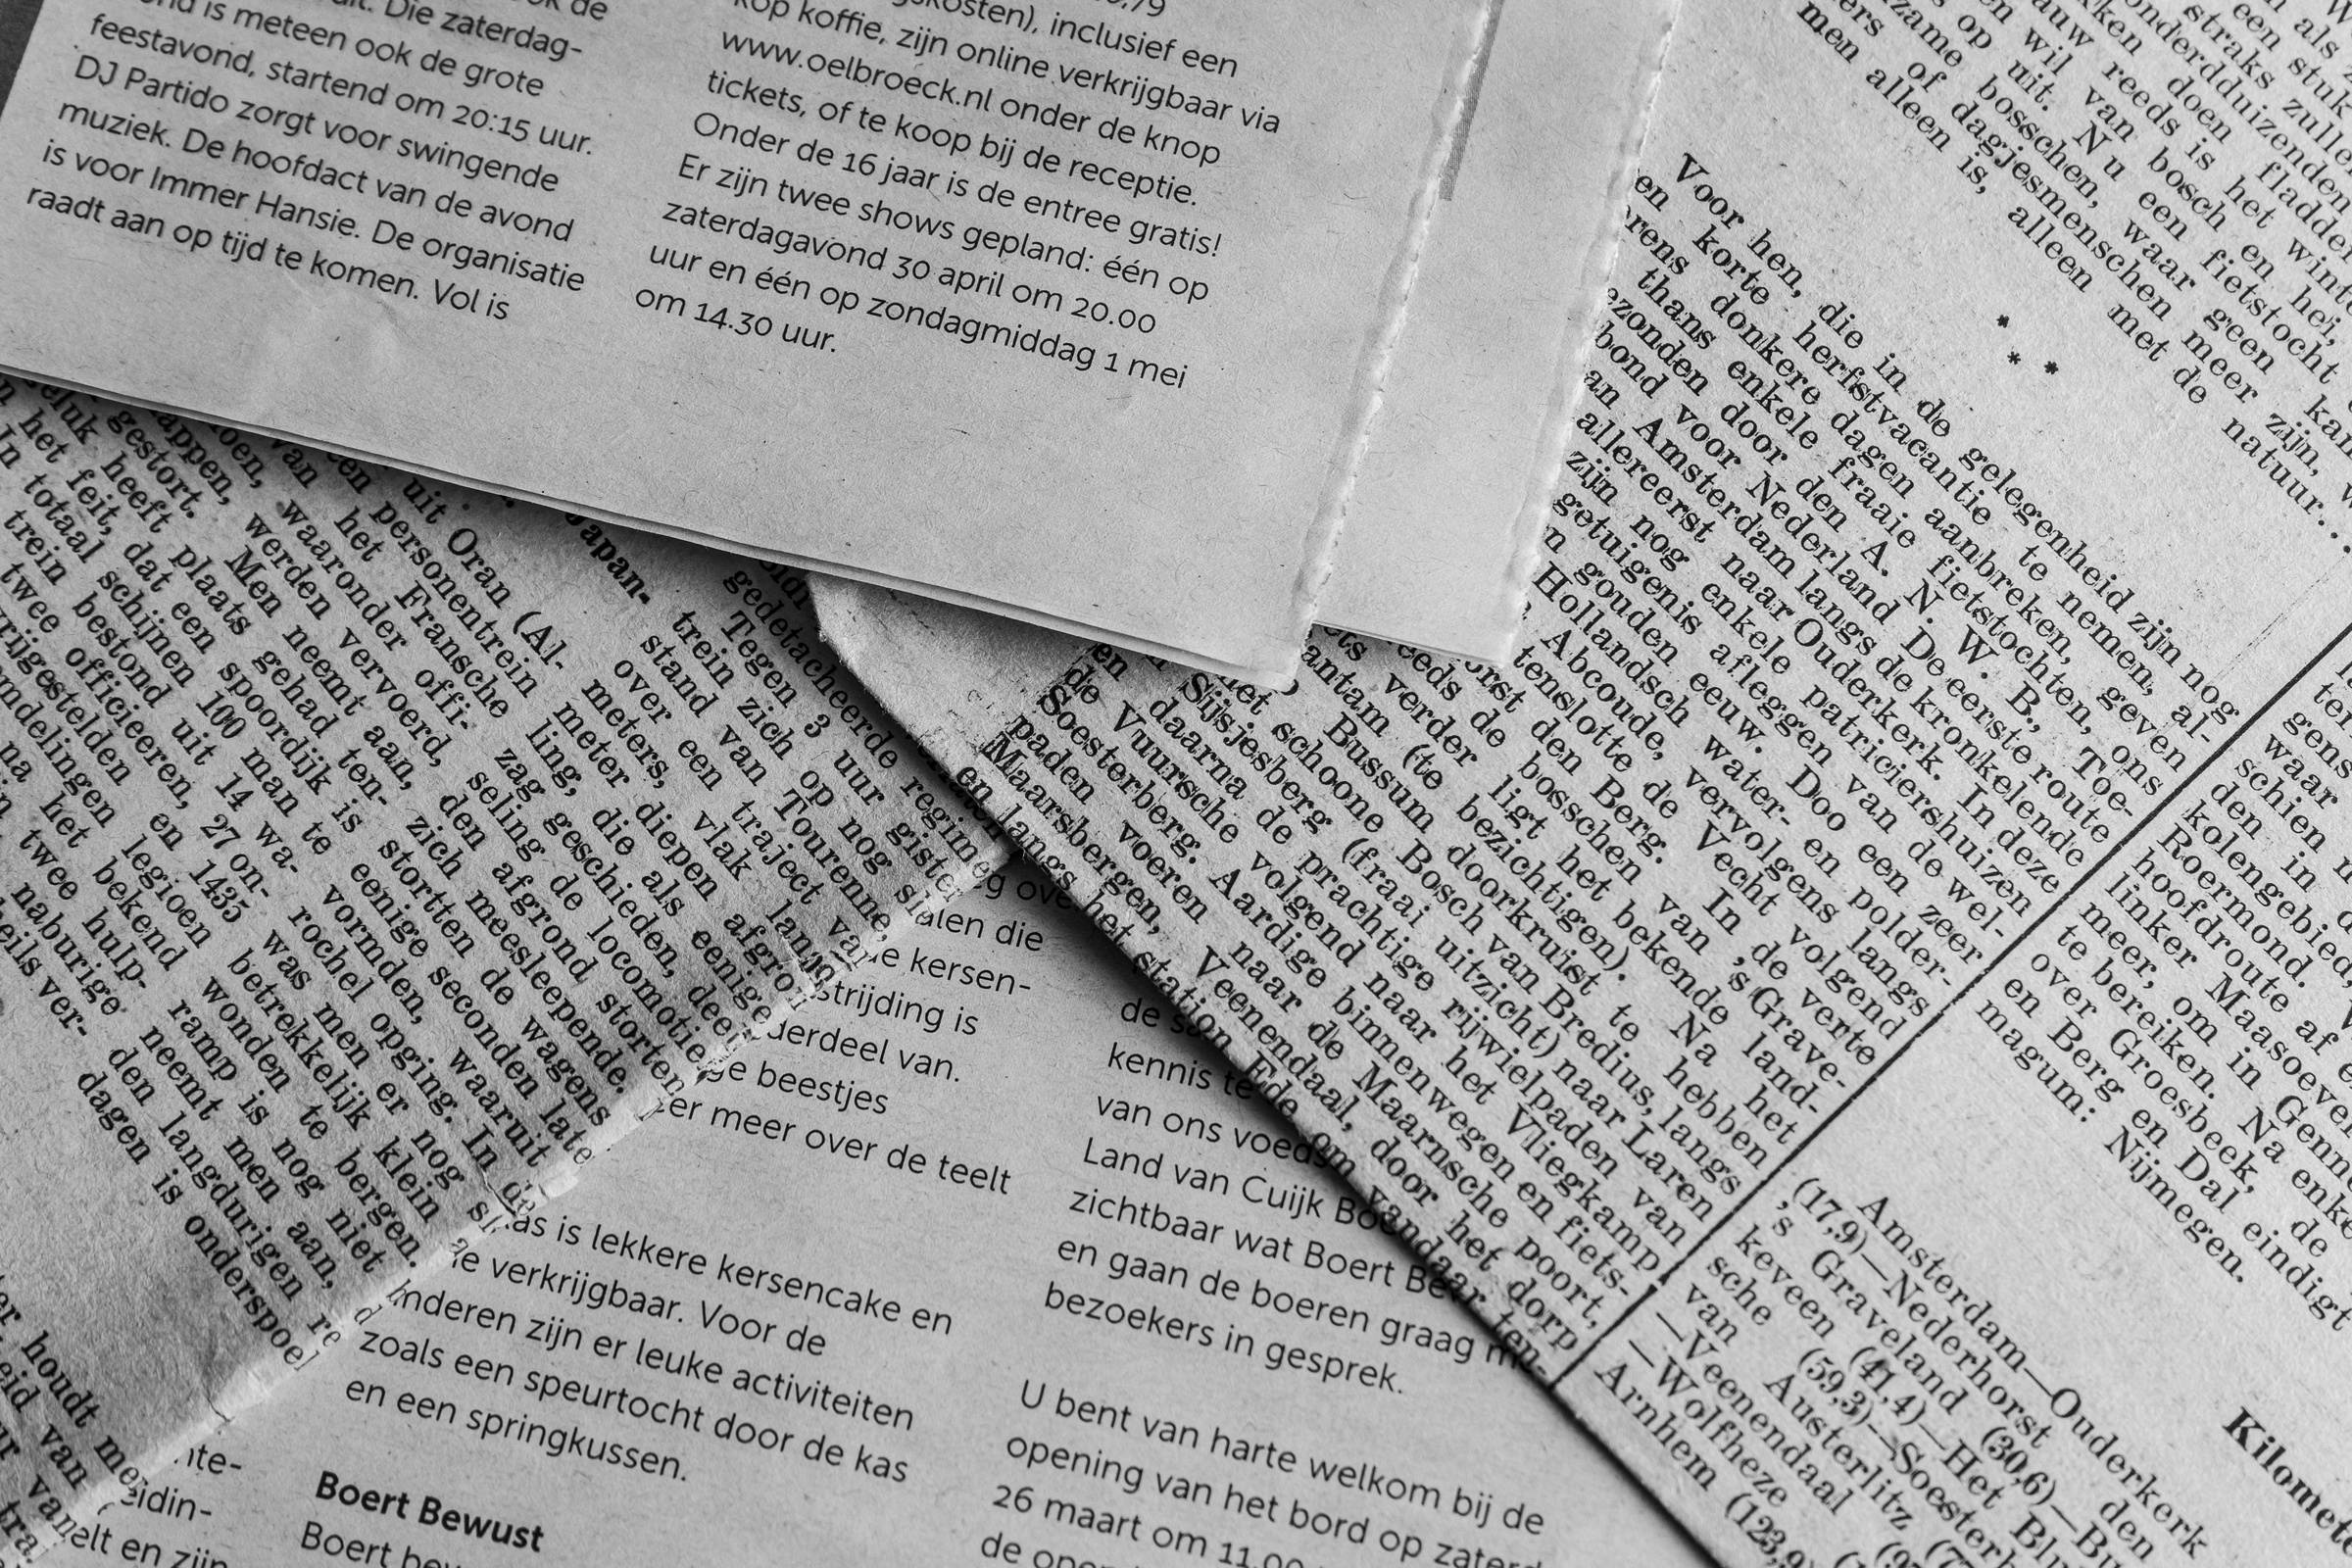
The different parts of this project
A
Part
Today: Brainstorm first ideas, topics, designs and assign the different roles. Fill out the project worksheet!
B
Part
At home: Write your article and design it on the platform. Keep your teacher in the loop and communicate with your group! Also: don’t forget your roles (e.g.: editor in chief, copy editor,...)
C
Part
2nd lesson: Get together and look over your newspaper. Is everything clear? Prepare for your presentation and the Awards!
TIPP: A messenger/whatsapp group might be practical

Slide 6

At the End
You’ll get an evaluation sheet and get the chance to rate the group’s newspapers.
At the end, the different groups will be nominated for 3 different Prizes.
Who will win which? Let’s find out!

Slide 7
Some Advice:
Use catchy headlines to attract readers’ attention
Use strong future expressions: will, might, could, may
Think like real journalists: inform, entertain, and surprise your audience.
Don’t copy information — create your own ideas!
Most importantly: HAVE FUN

Slide 8

Let’s share our project!
The Genially links will be emailed to parents, posted on the school website and shared via a QR code gallery in the school hallway.
After the project

